Slide 1
Hanoi University of Science and Technology
Object-Oriented Language and Theory Mini Project
Interactive simulation of the composition of forces

Slide 2
Our Team
All members working all tasks together including design class diagram, use case diagram, GUI design, package and class implementation, physics logic..
Đào Quang Dương
20194747
Nguyễn Đình Duy
Trần Ngọc Dung
20190096
20194742

Slide 3
Table of Contents
01
02
03
04
Problem & Solution
You could describe the
topic of the section here
Market Analysis and Target
You could describe the
topic of the section here
Our Process
You could describe the
topic of the section here
Our Consultants
You could describe the
topic of the section here

Slide 4
Problem statement
Project create a simple interactive simulation for demonstrating Newton’s laws of motion.
The system includes three components: one main object, the surface, forces which apply to object.
The user can control all the components as:
+ Select the shape of the object by dragging and dropping it in the center of the screen
+ Click right mouse to open, close menu to change the parameters of object
+ Change the external force parameter
+ Change coefficient of friction
+ Checkbox in the upper corner to select the parameters you want to see details
+ Pause, Continue, and Reset program
-> Program will calculate forces, sum of force, acceleration, current velocity, current position every 1 second.

Slide 5
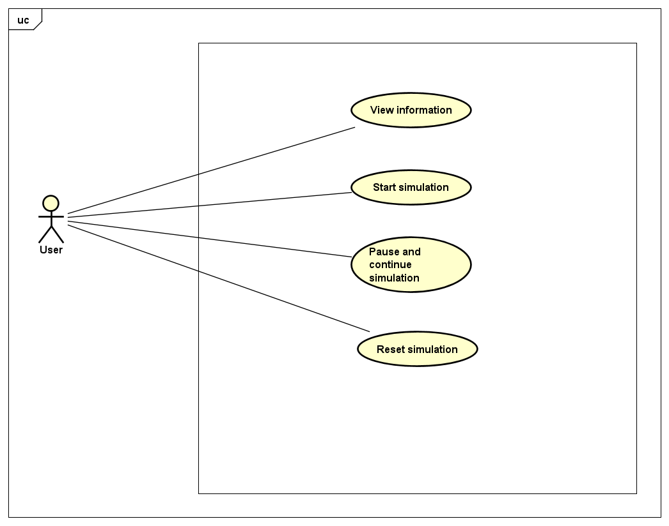
Use Case Diagram

Slide 6
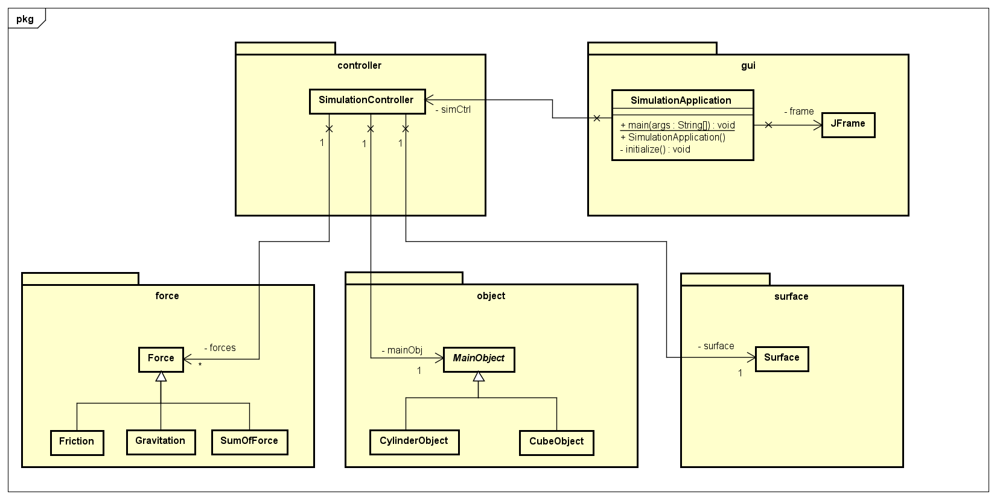
General Class Diagram

Slide 7
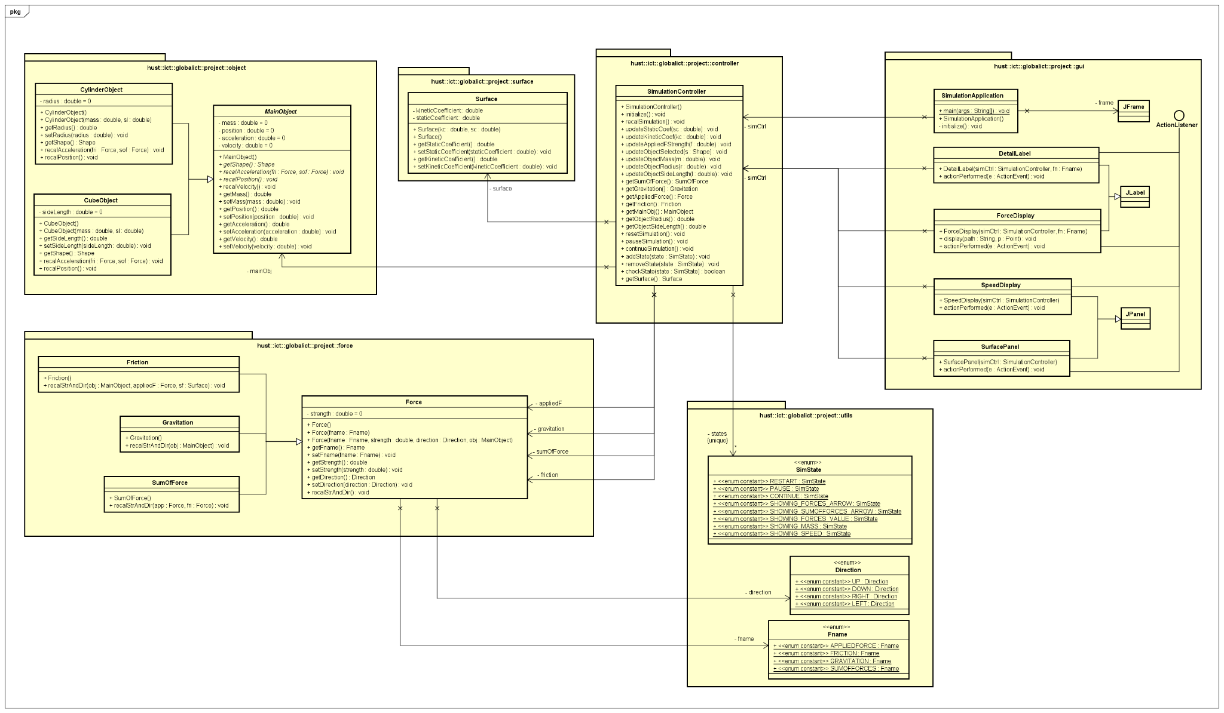
Detail Class Diagram

Slide 8
Detail Class Diagram

Slide 9
Detail Class Diagram

Slide 10
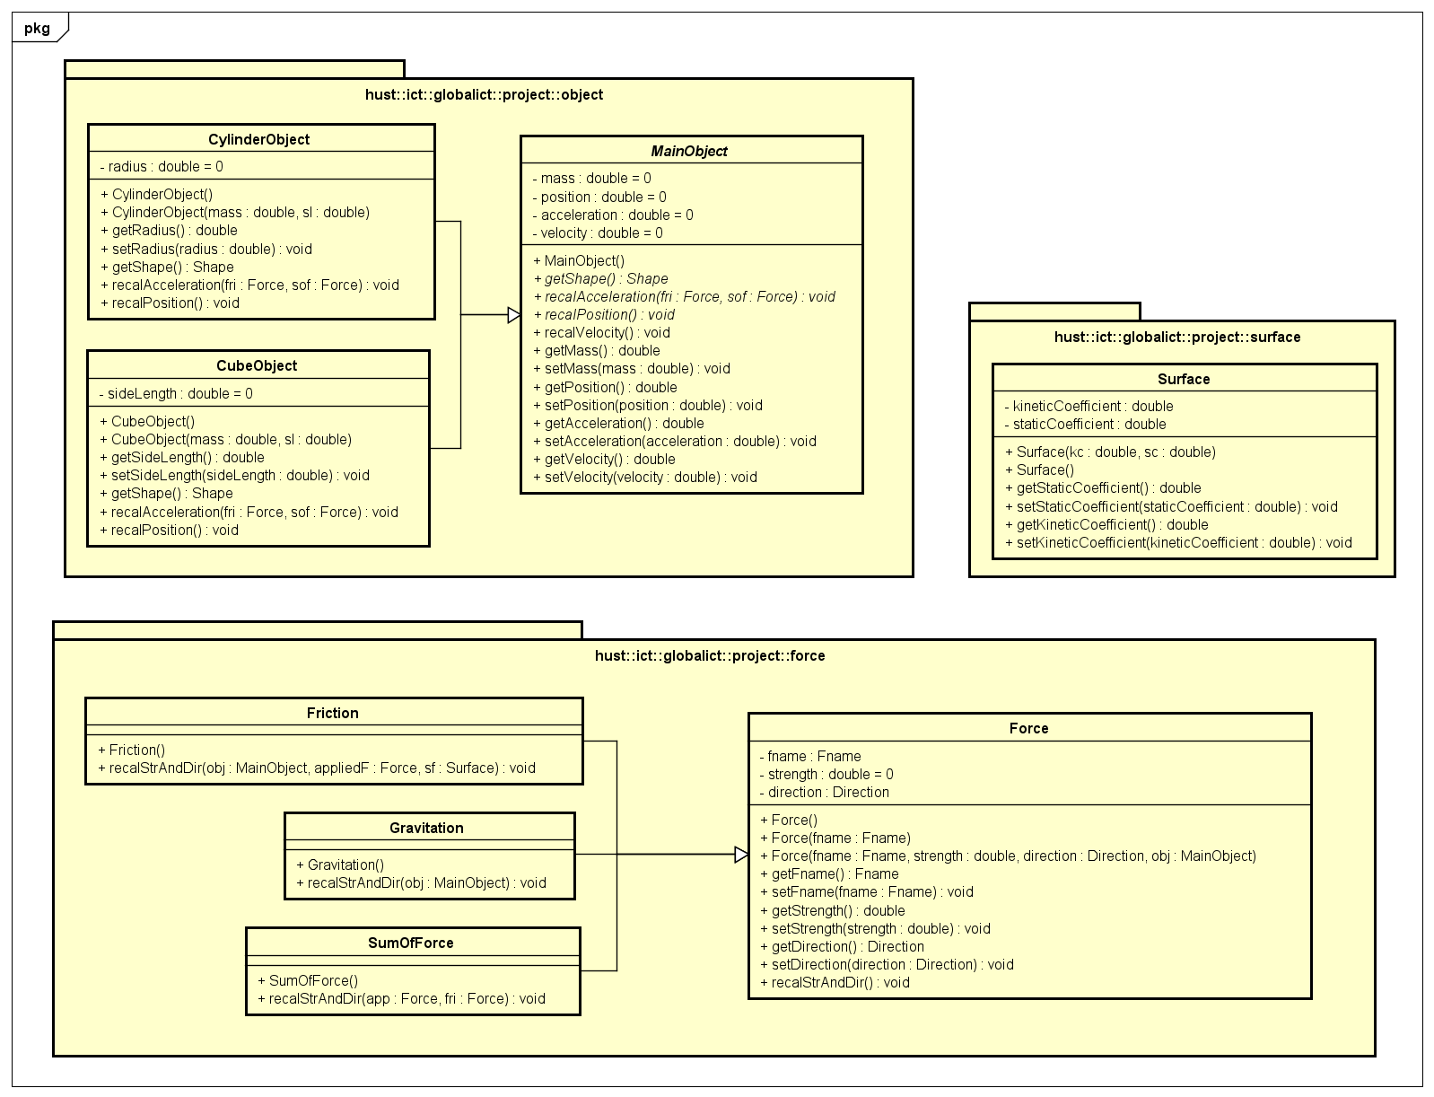
Detail Class Diagram
Modal Packages

Slide 11
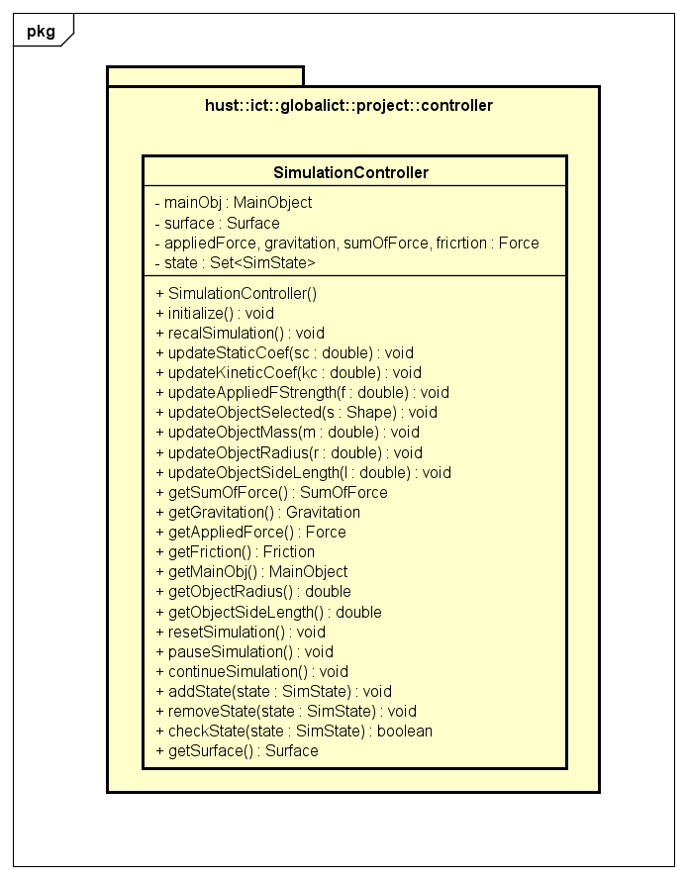
Detail Class Diagram
Controller Package

Slide 12
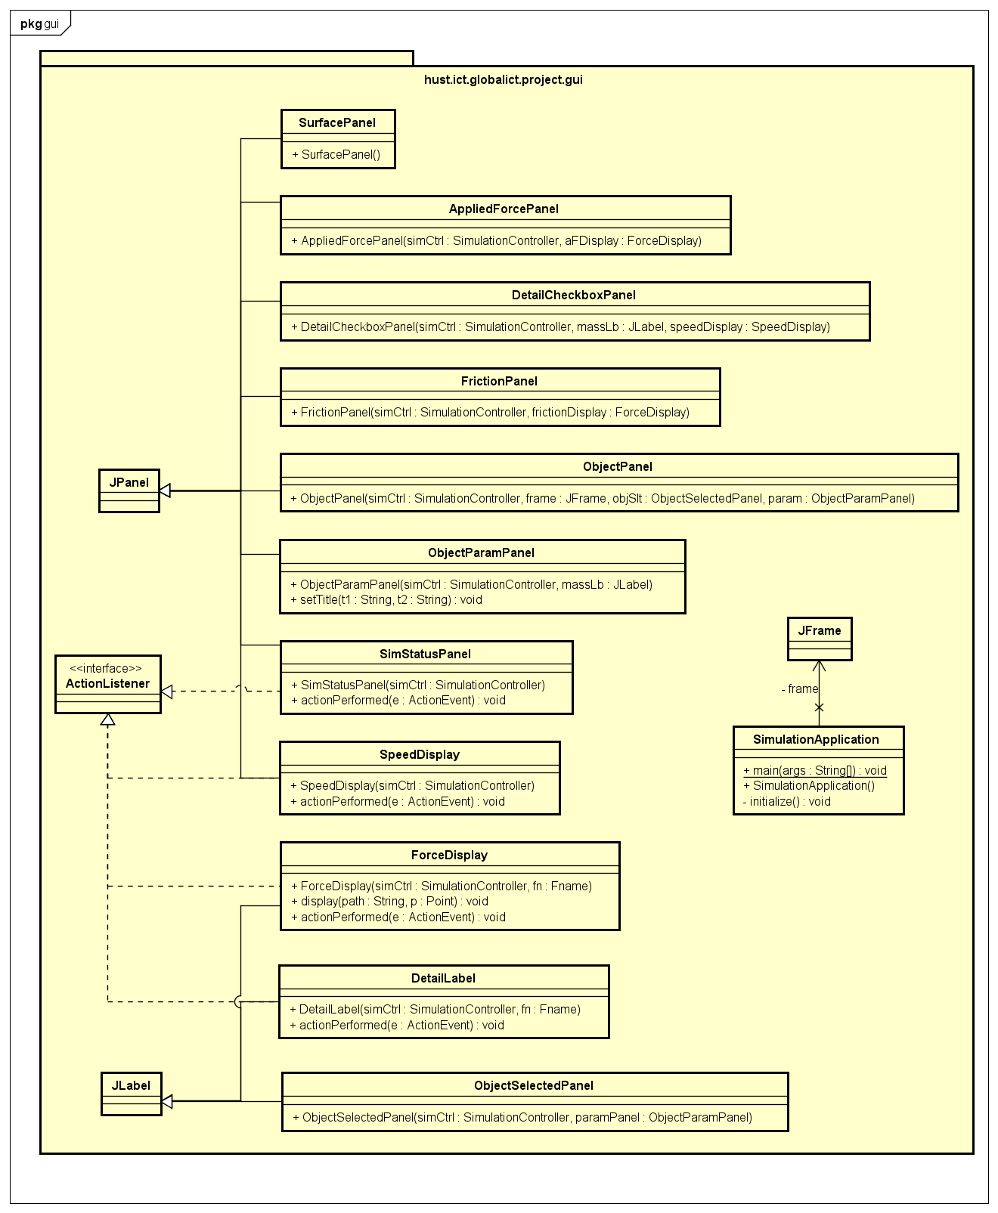
Detail Class Diagram
GUI Package

Slide 13
OOP Techniques
Encapsulation
- Declare the variables of a class as private.
- Provide public setter and getter methods to modify
and view the variables values.

Slide 14
OOP Techniques
Inheritance
- CylinderObject Class and CubeObject Class inherit
MainObject.
- Friction Class, Gravitation Class, SumOfForce Class
inherit Force Class.
DetailLabel Class, ForceDisplay Class inherit JLabel.
SpeedDisplay Class, SurfaceDisplay Class inherit JPanel.

Slide 15
OOP Techniques
Association
- SimulationController has 1-1 relationship with
Surface, MainObject.
- SimulationController handles some Force(s), 1-many
SimulationApplication is controlled by 1 SimulationController, 1-1 relationship.

Slide 16
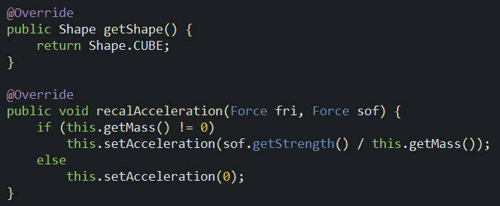
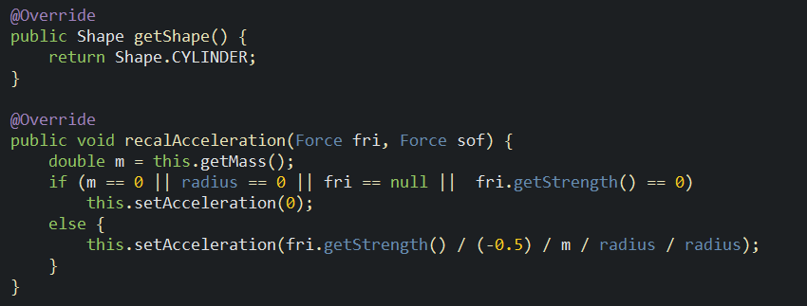
OOP Techniques
Polymorphism
CubeObject:
CylinderObject:

Slide 17
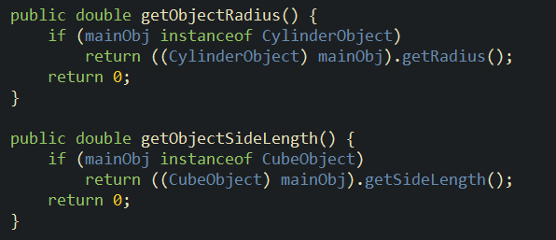
OOP Techniques
Polymorphism
SimulationController:
instanceof

Slide 18
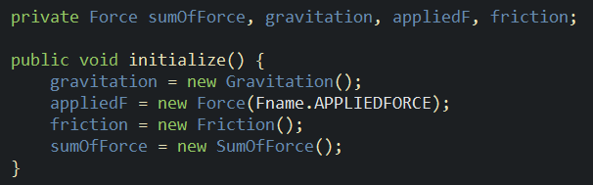
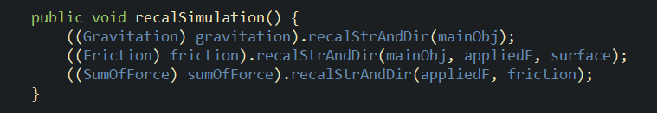
OOP Techniques
Up-casting & Down-casting
- SimulationController:

Slide 19
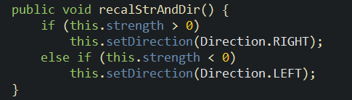
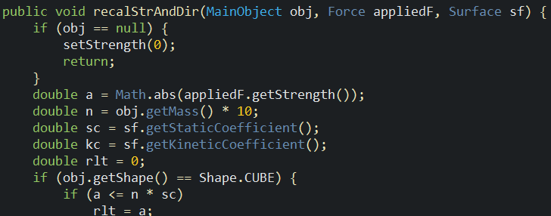
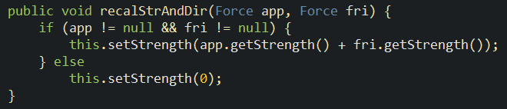
OOP Techniques
Overloading
- Force:
- Friction:
- SumOfForce:

Slide 20
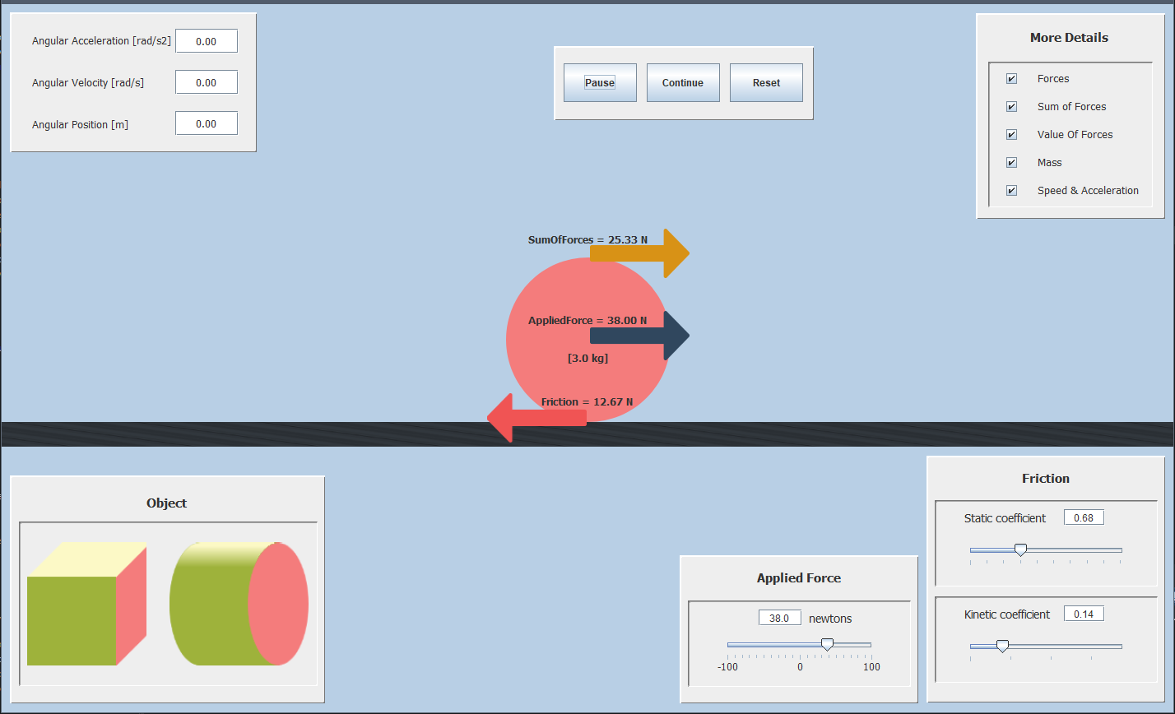
Demo Simulation App
Interactive simulation of the composition of forces - YouTube

Slide 21
Thanks!

